Slide 1
M110: Python Programming Meeting #10 Classes and Object-Oriented Programming
Prepared by Dr. Ahmad Mikati

Slide 2
Topics
Procedural and Object-Oriented Programming
Classes
Working with Instances
Techniques for Designing Classes
Inheritance

Slide 3
Procedural Programming
Procedural programming: is a method of writing software. It is a programming practice centered on the procedures or actions that take place in a program.
Procedural programming is in short writing programs made of functions that perform specific tasks
Procedures typically operate on data items that are separate from the procedures
Data items commonly passed from one procedure to another
Focus: to create procedures that operate on the program’s data

Slide 4
Object-Oriented Programming (1 of 2)
Object-oriented programming: Whereas procedural programming is centered on creating procedures (functions), object-oriented programming (OOP)is focused on creating objects
Object: An object is a software entity that contains data and procedures.
An object’s data attributes are simply variables that reference data.
The procedures that an object performs are known as methods.
An object’s methods are functions that perform operations on the object’s data attributes.
The object is, conceptually, a self-contained unit that consists of data attributes and methods that operate on the data attributes.
Data is known as data attributes and procedures are known as methods.
Methods perform operations on the data attributes.

Slide 5
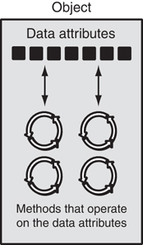
Object-Oriented Programming (2 of 2)
Figure 1: An object contains data attributes and methods

Slide 6
Classes
Before an object can be created, it must be designed by a programmer. The programmer determines the data attributes and methods that are necessary, then creates a class.
Class: is a code that specifies the data attributes and methods of a particular type of object. A class is considered as a factory to create objects.
Like a blueprint* of a house. The blueprint itself is not a house but is a detailed description of a house.
A Python class uses variables (attributes) to define data fields and methods to define behaviors.
Instance: is an object created from a class
Like a specific house built according to the blueprint.
There can be many instances of one class. Each house is a separate instance of the house described by the blueprint.
* blueprint :a design plan or other technical drawing

Slide 7
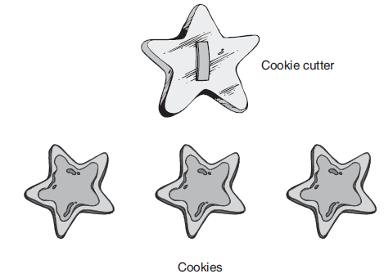
Classes
A way of thinking about the difference between a class and an object is to think of the difference between a cookie cutter and a cookie. While a cookie cutter itself is not a cookie, it describes a cookie. The cookie cutter can be used to make several cookies, as shown in Figure 3. Think of a class as a cookie cutter, and the objects created from the class as cookies.
So, a class is a description of an object’s characteristics. When the program is running, it can use the class to create, in memory, as many objects of a specific type as needed.
Each object that is created from a class is called an instance of the class.
Figure 3 the cookie cutter metaphor

Slide 8
Classes
Instances have two characteristics: They have states and behaviors (an instance has attributes and methods attached to it)
Attributes represent its state, and methods represent its behavior.
Using its methods, we can modify its state.
In short, Every instance has the following properties:
Identity: Every instance must be uniquely identified.
State: An instance has an attribute that represents a state of an instance, and it also reflects the property of an instance.
Behavior: An instance has methods that represent its behavior.

Slide 9
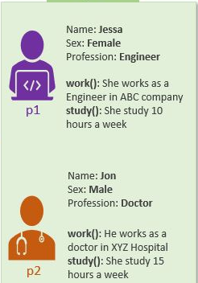
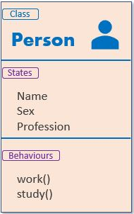
Classes
For example, If we design a class based on the states and behaviors of a Person, then States can be represented as instance variables and behaviors as class methods.
Instances
instance variables
instance methods
Figure 4 class and instances in Python
Both instances (p1 and p2) are created from the same class, but they have different states and behaviors.

Slide 10
Class Definitions
In Python, class is defined by using the class keyword.
The syntax to create a class is given below.
class class_name:
'''This is a docstring. I have created a new class'‘’
<statement 1>
<statement 2>
.
.
<statement N>
To create a class, you write a class definition.
class_name: It is the name of the class
Class names often start with uppercase letter
Docstring: It is the first string inside the class with a brief description of the class.
statements: Attributes and methods
Method definition is like any other python function definition
self parameter: required in every method in the class – references the specific object that the method is working on

Slide 11
Class Definitions- example
Example:
class Point:
x = 0
y = 0
# main
p1 = Point()
p1.x = 2
p1.y = -5
point.py
1 2 3 | class Point: x = 0 y = 0

Slide 12
Using a Class
import class
client programs must import the classes they use
point_main.py
1 2 3 4 5 6 7 8 9 10 | from Point import * # main p1 = Point() p1.x = 7 p1.y = -3 ... # Python objects are dynamic (can add fields any time!) p1.name = “Salim Hamad"

Slide 13
Object Methods
def name(self, parameter, ..., parameter):
statement(s)
self must be the first parameter to any object method
represents the "implicit parameter" (this in Java)
Although you must specify self explicitly when defining the method, you don’t include it when calling the method.
Python passes it for you automatically.
class Point:
def translate(self, dx, dy):
self.x += dx
self.y += dy
...
Defining a method in class Point:
Calling a method:
…
>>> p1.translate(1.5,2)

Slide 14
Calling Methods
A client can call the methods of an object in two ways:
(the value of self can be an implicit or explicit parameter)
1) object.method(parameters)
or
2) Class.method(object, parameters)
Example:
p1.translate(1, 5)
Point.translate(p, 1, 5)

Slide 15

Class Methods: Example
class Person:
name = "I have no name :("
def sayName(self):
print("My name is...", self.name)
def main():
aPerson = Person()
aPerson.sayName()
aPerson.name = "Big Smiley :D"
aPerson.sayName()
main()

Slide 16
What Is The ‘Self’ Parameter
Reminder: When defining/calling methods of a class there is always at least one parameter.
This parameter is called the ‘self’ reference which allows an object to access attributes inside its methods.
‘self’ is needed to distinguish the attributes of different objects of the same class.
Example:
bassem = Person()
lisa = Person()
lisa.sayName()
No self!
No self!
def sayName():
print "My name is...", name
Whose name is this? (This won’t work!)

Slide 17
The Self Parameter: A Complete Example
class Person:
name = "I have no name :("
def sayName(self):
print("My name is...", self.name)
def main():
lisa = Person()
lisa.name = "Lisa Haddad, pleased to meet you."
bassem = Person()
bassem.name = "I'm Bassem Hassan, who are you???!!!"
lisa.sayName()
bassem.sayName()
main()

Slide 18
Recap: Accessing Attributes & Methods
Inside the class definition (inside the body of the class methods)
Preface the attribute or method using the ‘self’ reference
class Person:
name = "No-name"
def sayName(self):
print("My name is...", self.name)
Outside the class definition
Preface the attribute or method using the name of the reference used when creating the object.
def main():
lisa = Person()
bart = Person()
lisa.name = "Lisa Haddad, pleased to meet you."

Slide 19
Class Definitions: Initializing The Attributes
Classes have a special method that can be used to initialize the starting values of a class to some specific values.
This method is automatically called whenever an object is created.
Format:
class <Class name>:
def __init__(self, <other parameters>):
<body of the method>
Example:
class Person:
name = ""
def __init__(self):
self.name = "No name"
Two underscores without spaces between them
This design approach is consistent with many languages

Slide 20
Class Definitions
Initializer method: automatically executed when an instance of the class is created
Initializes object’s data attributes and assigns self parameter to the object that was just created
Format: def __init__ (self):
Usually, the first method in a class definition
class Point:
def __init__(self, ax, ay):
self.x = ax
self.y = ay
class Coin:
# The _ _init_ _ method initializes the sideup data attribute with 'Heads’.
def _ _init_ _(self):
self.sideup = 'Heads'

Slide 21
Class Definitions
To create instances of a class, you call the class using class name (and pass in whatever arguments its __init__ method accepts).
Format: My_instance = Class_Name()
To call any of the class methods using the created instance, use dot notation
Format: My_instance.method()
Because the self parameter references the specific instance of the object, the method will affect this instance
Reference to self is passed automatically

Slide 22
Initializing The Attributes Of A Class
Because the ‘init()’ is a method, it can also be called with parameters which are then used to initialize the attributes.
Example:
# Attribute is set to a default in the class definition and then the
# attribute can be set to a non-default value in the init() method.
# (Not standard Python but a common approach with many languages)
class Person:
name = "Default name" # Create attribute here
def __init__(self, aName):
self.name = aName
OR
# Create the attribute in the init() method. (Approach often used in Python).
class Person:
def __init___(self, aName):
self.name = aName # Create attribute here

Slide 23
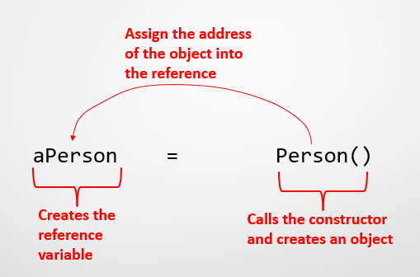
Using The “Init()” Method-Example
class Person:
name = “No name"
def __init__(self, aName):
self.name = aName
def main():
aPerson = Person(“Jamal Nader")
print(aPerson.name)
main()
Output:
Jamal Nader

Slide 24
Person Class Example
Write a Python class Person that represents a person with the attributes name, age, and profession. The class should have an initializer method __init__() to initialize the instance variables. It should also have two instance methods: show() to display the name, age, and profession of the person, and work() to display the person's name and profession.
The program should also:
Prompt the user to enter their name, age, and profession.
Create an object of the Person class using the entered values.
Call the show() and work() methods on the object to display the person's details and profession, respectively.

Slide 25
Person Class-Solution
class Person:
def __init__(self, aname, anage, aprofession):
# data members (instance variables)
self.name = aname
self.age = anage
self.profession = aprofession
# Behavior (instance methods)
def show(self):
print('Name:', self.name, '\tAge:', self.age, '\tProfession:', self.profession)
# Behavior (instance methods)
def work(self):
print(self.name, 'is working as a/an', self.profession)
myname = input("Enter the name: ")
myAge = input("Enter the Age: ")
myProfession = input("Enter the profession: ")
p = Person(myname, myAge, myProfession)
p.show()
p.work()

Slide 26
Computation class Example
You are requested to write a python program that does the following:
Create Computation class with a default constructor (without parameters) allowing to perform various calculations on integers numbers.
Create a method called Factorial() in the above class which allows to calculate the factorial of an integer, n.
Create a method called Sum() in the above class allowing to calculate the sum of the first n integers 1 + 2 + 3 + .. + n.
Instantiate the class, prompt the user to enter an integer, and write the necessary statements to test the above methods.

Slide 27
Computation class - Solution
class Computation:
def __init__ (self):
self.n=0
# --- Factorial ------------
def factorial(self, n):
j = 1
for i in range (1, n + 1):
j = j * i
return j
# --- Sum of the first n numbers ----
def sum (self, n):
j = 0
for i in range (1, n + 1):
j = j + i
return j
x= Computation()
n=int(input("Enter an integer: "))
print("The factorial of the number",n, "is:",x.factorial(n))
print("The sum from the number",n, " to 1 is:",x.sum(n))

Slide 28
Class Attributes vs Instance Attributes in Python
Class attributes are the variables defined directly in the class that are shared by all objects of the class.
Instance attributes are attributes or properties attached to an instance of a class. Instance attributes are defined in the constructor.
Class Attribute | Instance Attribute
Defined directly inside a class. | Defined inside a constructor using the self parameter.
Shared across all objects. | Specific to object.
Accessed using class name as well as using object with dot notation, e.g. classname.class_attribute or object.class_attribute | Accessed using object dot notation e.g. object.instance_attribute
Changing value by using: classname.class_attribute = value will be reflected to all the objects. | Changing value of instance attribute will not be reflected to other objects.

Slide 29
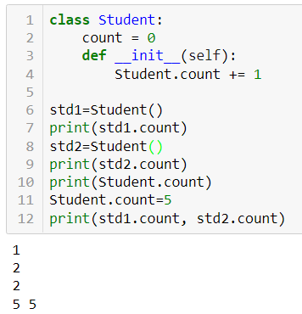
Class Attributes vs Instance Attributes in Python
The following example demonstrates the use of class attribute count.
class Student:
count = 0
def __init__(self):
Student.count += 1
In this example, count is an attribute in the Student class. Whenever a new object is created, the value of count is incremented by 1.
std1=Student()
print(std1.count)
std2=Student()
print(std2.count)
print(Student.count)
Student.count=5
print(std1.count, std2.count)

Slide 30
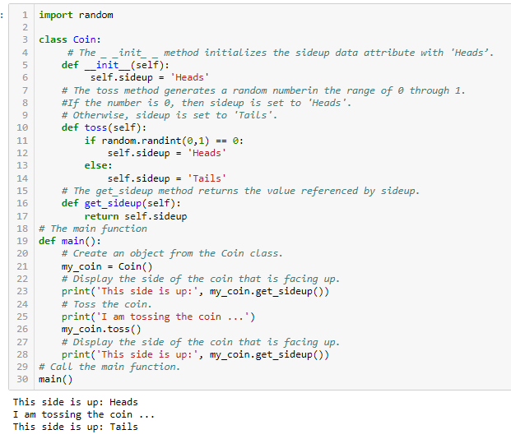
Coin Class Example
N.B: In line 1, we import the random module. This is necessary because we use the randint function to generate a random number

Slide 31
import random
class Coin:
# The _ _init_ _ method initializes the sideup data attribute with 'Heads’.
def __init__(self):
self.sideup = 'Heads'
# The toss method generates a random number in the range of 0 through 1.
#If the number is 0, then sideup is set to 'Heads'.
# Otherwise, sideup is set to 'Tails'.
def toss(self):
if random.randint(0,1) == 0:
self.sideup = 'Heads'
else:
self.sideup = 'Tails'
# The get_sideup method returns the value referenced by sideup.
def get_sideup(self):
return self.sideup
# The main function
def main():
# Create an object from the Coin class.
my_coin = Coin()
# Display the side of the coin that is facing up.
print('This side is up:', my_coin.get_sideup())
# Toss the coin.
print('I am tossing the coin ...')
my_coin.toss()
# Display the side of the coin that is facing up.
print('This side is up:', my_coin.get_sideup())
# Call the main function.
main()

Slide 32
Summary
This lecture covered:
Procedural vs. object-oriented programming
Classes and instances
Class definitions, including:
The self parameter
Data attributes and methods
initializer

